Slide 1
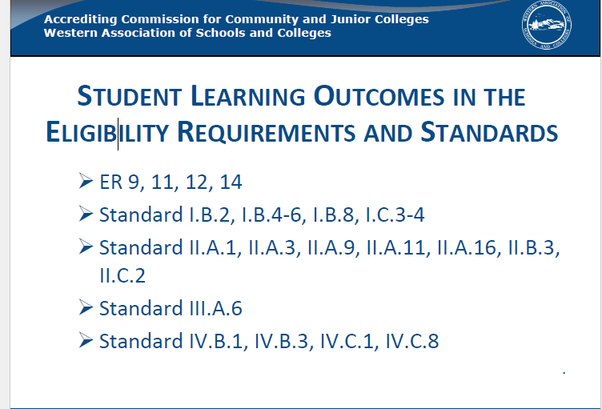

Slide 2
ACCJC Standards
I.B.5. The institution assesses accomplishment of its mission through program review and evaluation of goals and objectives, student learning outcomes, and student achievement. Quantitative and qualitative data are disaggregated for analysis by program type and mode of delivery.
I.B.6. The institution disaggregates and analyzes learning outcomes and achievement for subpopulations of students. When the institution identifies performance gaps, it implements strategies, which may include allocation or reallocation of human, fiscal and other resources, to mitigate those gaps and evaluates the efficacy of those strategies.

Slide 6
Student Development All Faculty
Student Development – Counseling Center Faculty

Slide 7
Longitudinal
DIESEL 021 | SLO 1 | SLO 2 | SLO 3
ALL | 98% | 59% | 92%
DIESEL 021 | SLO 1 | SLO 2 | SLO 3
Spring 2014 | 100% | 30% | 90%
DIESEL 021 | SLO 1 | SLO 2 | SLO 3
Spring 2015 | 100% | 81% | 100%

Slide 8
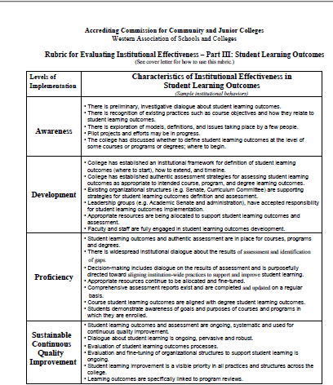

Slide 9
Sustainable Continuous Quality Improvement | • Student learning outcomes and assessment are ongoing, systematic and used for continuous quality improvement. • Dialogue about student learning is ongoing, pervasive and robust. • Evaluation of student learning outcomes processes. • Evaluation and fine-tuning of organizational structures to support student learning is ongoing. • Student learning improvement is a visible priority in all practices and structures across the college. • Learning outcomes are specifically linked to program reviews.

Slide 10
SLO Process
Every Section - Every Semester
3-Year Evaluation Cycle for Courses and Program

Slide 11
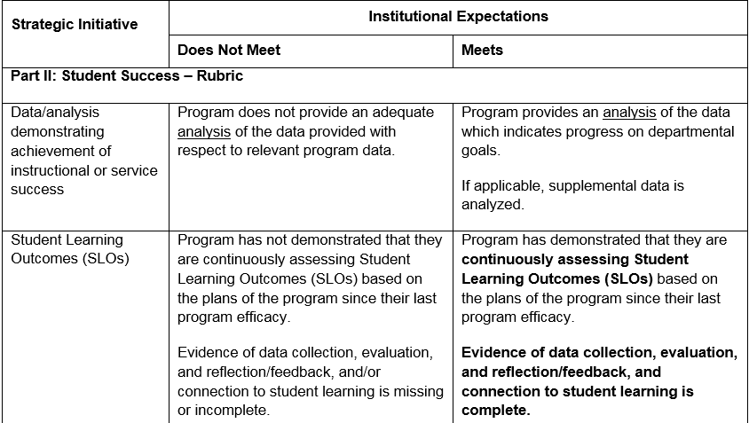
Program Efficacy Rubric

Slide 12
Program Efficacy Questions
Student Learning Outcomes
Course SLOs. Demonstrate that your program is continuously assessing Course Student Learning Outcomes (SLOs), based on the plans of the program since the last efficacy review. Include evidence of data collection, evaluation, and reflection/feedback, and describe how the SLOs are being used to improve student learning (e.g., faculty discussions, SLO revisions, assessments, etc.). Generate reports from the SLO Cloud as necessary. Include analysis of SLO Cloud reports and data from 3-year summary reports. This section is required for all programs.
Program Level Outcomes: If your program offers a degree or certificate, describe how the program level outcomes are being used to improve student learning at the program level (e.g., faculty discussions, SLO revisions, assessments, etc.). Discuss how this set of data is being evaluated or is planned to be evaluated. Generate reports from the SLO Cloud as necessary. Include analysis of SLO Cloud reports and data from 3-year summary reports. If your program does not offer a degree or certificate, this section is optional (but encouraged).

Slide 13
SLO Process Proposal
Continue ongoing collection of Assessment Data
FA16 Explore expanding Outcomes Assess to a 4-Year cycle that aligns with Program Efficacy
Program Evaluation
Course Evaluations
SP17 Update and enhance Outcomes Processes handbook to reflect changes

